Slide 1
Leaflet and D3: OH MY
Alex Bostic
TuGIS 2015
March 17, 2015

Slide 2
What we will cover
What Is Leaflet
What is D3
Combining Leaflet and D3
Example Applications

Slide 3

What is Leaflet
Open Source Mapping Library
Lightweight
Extremely Fast
Mobile Ready
Active Community
Notes:
http://riverwatch.wq.io/

Slide 4
Why use Leaflet
No licensing cost
Works with all types of data
Open Street Map, Esri, Google
Easy to get started
Works well in any development environment
Notes:
https://chocolatey.org/

Slide 5
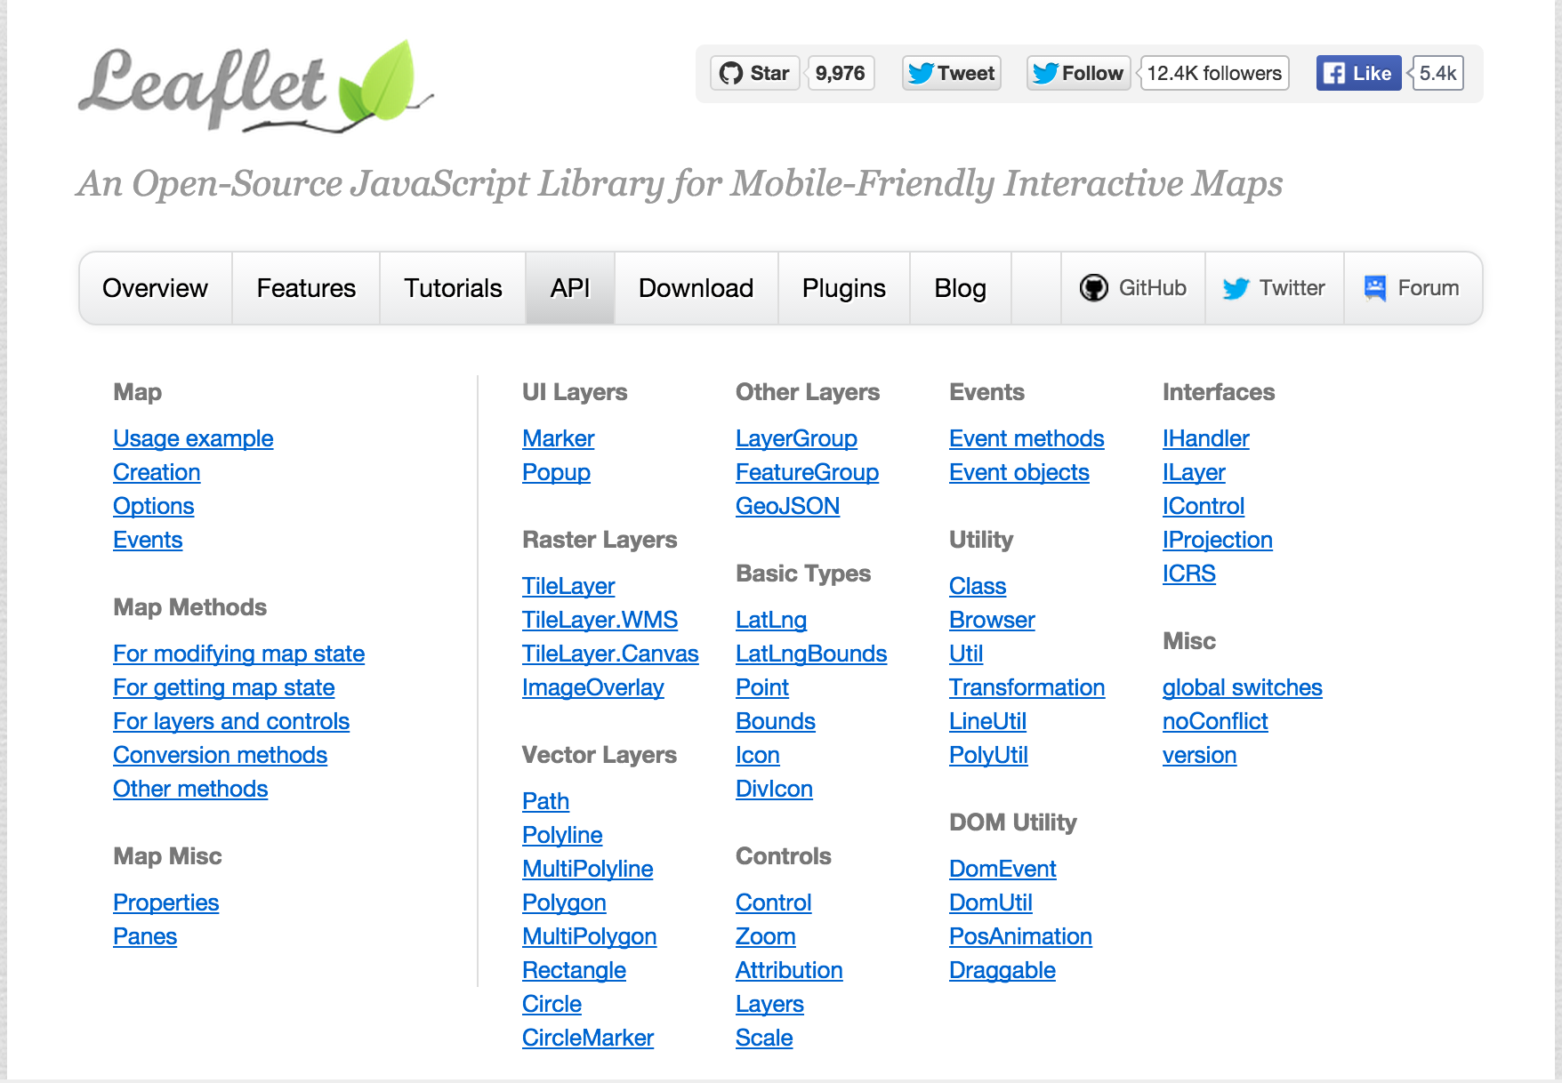
Notes:
https://chocolatey.org/

Slide 6
Getting Started
<div id="map-container" style="height:400px"></div>
var map = L.map("map-container")
.setView([46.5, -94.5], 6)
.locate({"setView": true});
// Add a tile layer
var layer = new L.TileLayer(
"http://{s}.tile.osm.org/{z}/{x}/{y}.png"
);
map.addLayer(layer);
Notes:
http://riverwatch.wq.io/

Slide 7
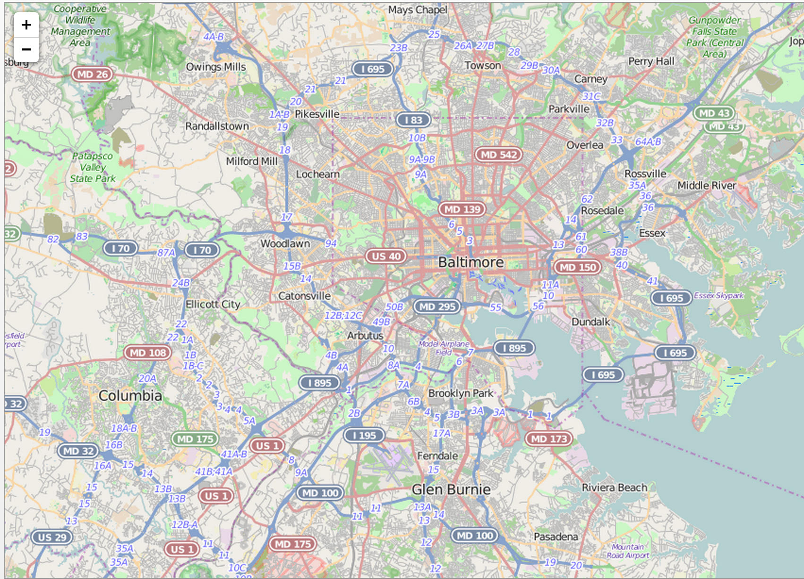
Notes:
http://riverwatch.wq.io/

Slide 8

What is D3
Open Source Visualization Library
Lightweight
Extremely Fast
Mobile Ready
Active Community

Slide 9
Why use Leaflet
No licensing cost
Works with all types of data
Easy to get started but extremely powerful
Works well in any development environment
Notes:
https://chocolatey.org/

Slide 10
Getting Started
d3.select(".chart")
.selectAll("div")
.data(data)
.enter().append("div")
.style("width", function(d) { return x(d) + "px"; })
.text(function(d) { return d; });
Notes:
https://github.com/mbostock/d3/wiki/Gallery

Slide 11
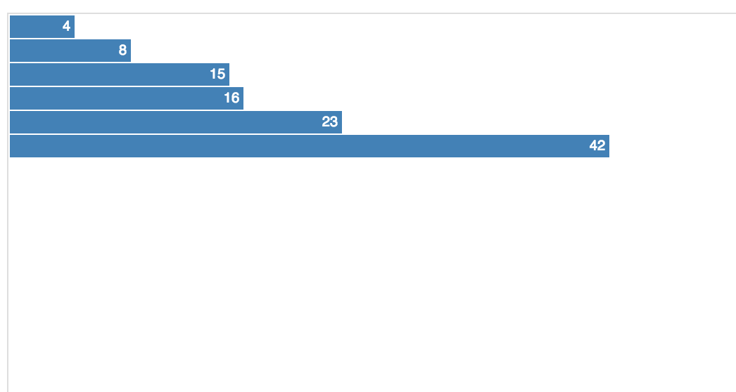
Notes:
http://riverwatch.wq.io/

Slide 12
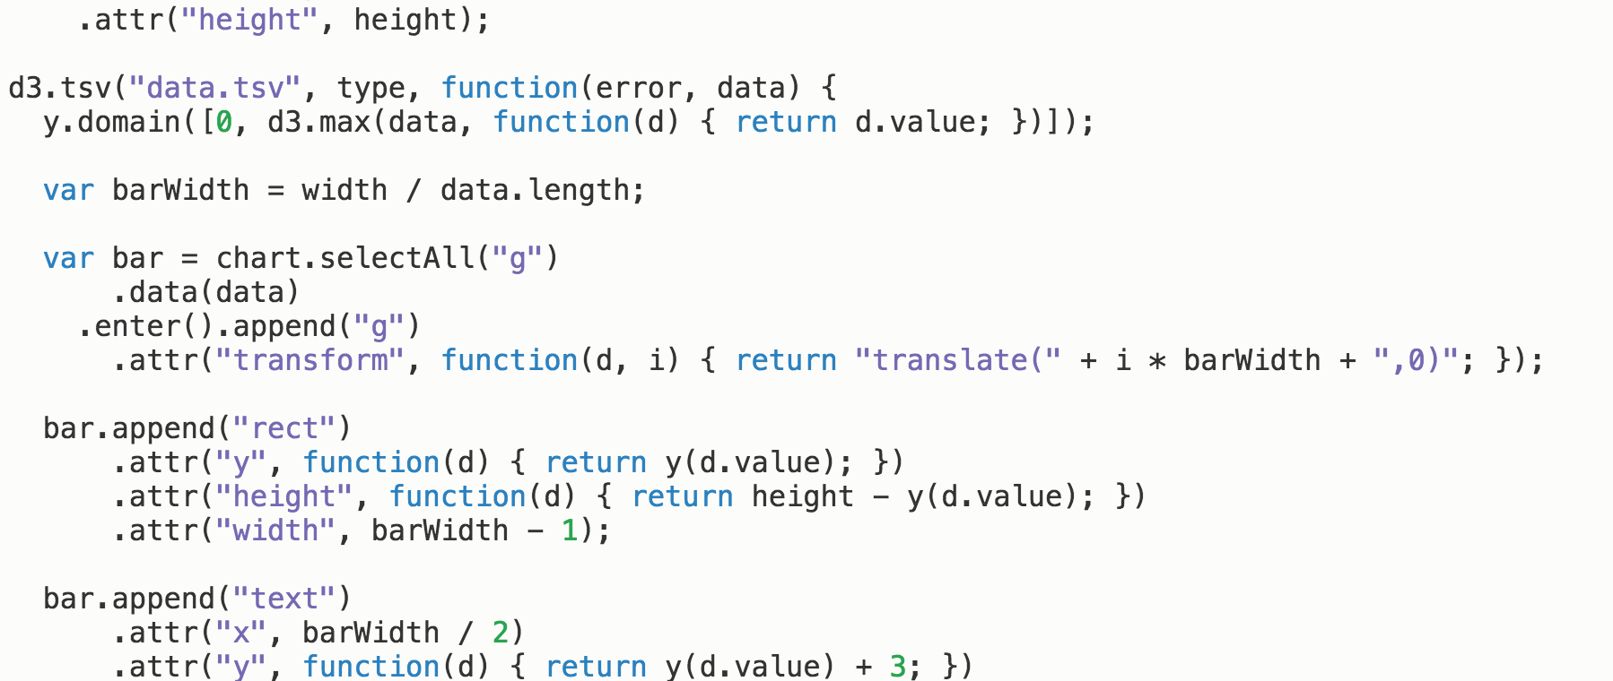
Getting Started
Notes:
https://github.com/mbostock/d3/wiki/Gallery

Slide 13
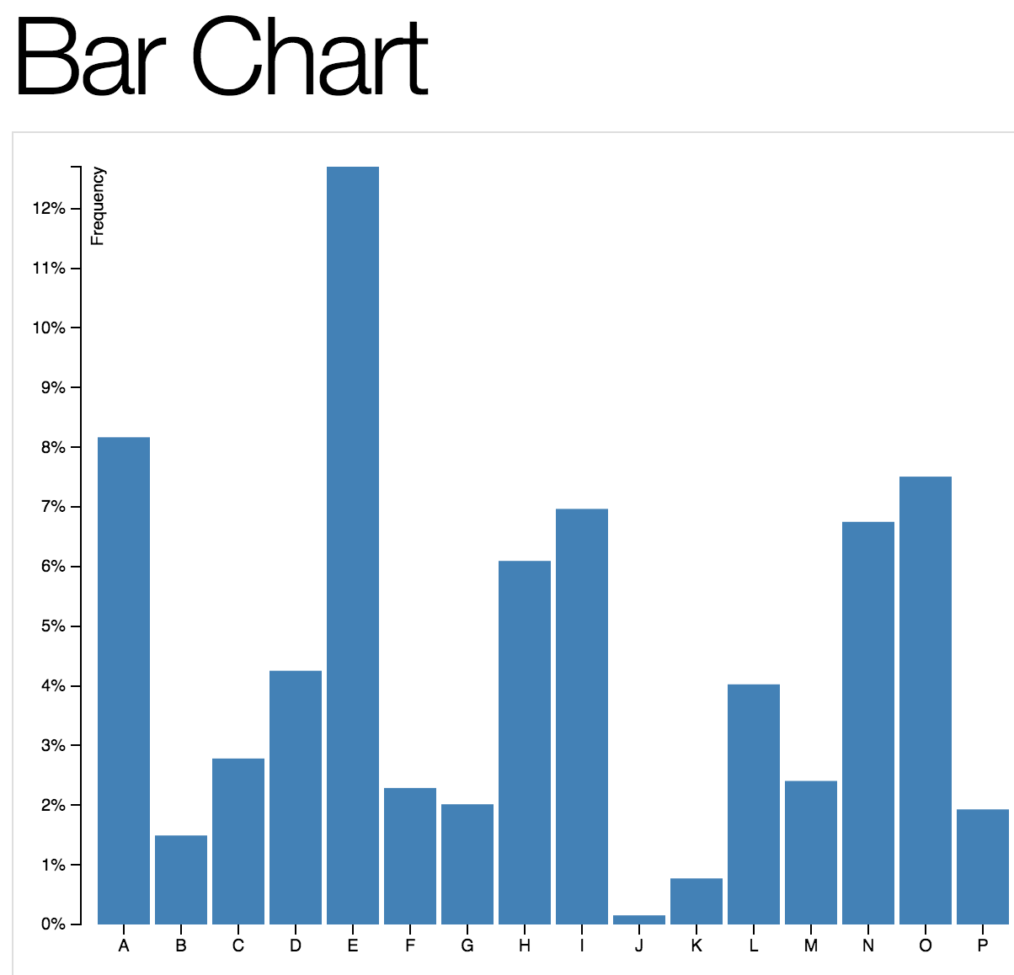
Notes:
http://riverwatch.wq.io/

Slide 14
Joining Forces
Notes:
https://github.com/mbostock/d3/wiki/Gallery

Slide 15
What can be done
Powerful mapping applications
Map and chart interactions
Animated maps
Markers, Lines, Polygons
Interactive user controls
Let’s check out some examples
Notes:
http://mbostock.github.io/d3/talk/20111018/force-states.html
http://chriszetter.com/voronoi-map/examples/uk-supermarkets/
http://www.slideshare.net/blueraster/building-a-custom-ui-control-with-d3
http://localhost:8888/LLD3
http://nyctaxi.herokuapp.com/

Slide 16
Questions
Alex Bostic
Email:alex.bostic@aecom.com
Twitter:@habostic
March 17, 2015
Page 16

